Slide 1

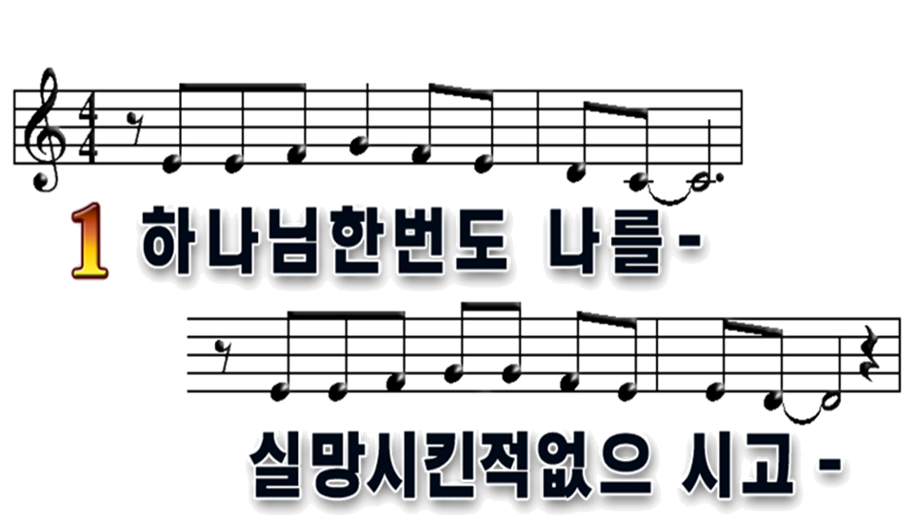

1
2

Slide 2

1
2

Slide 3
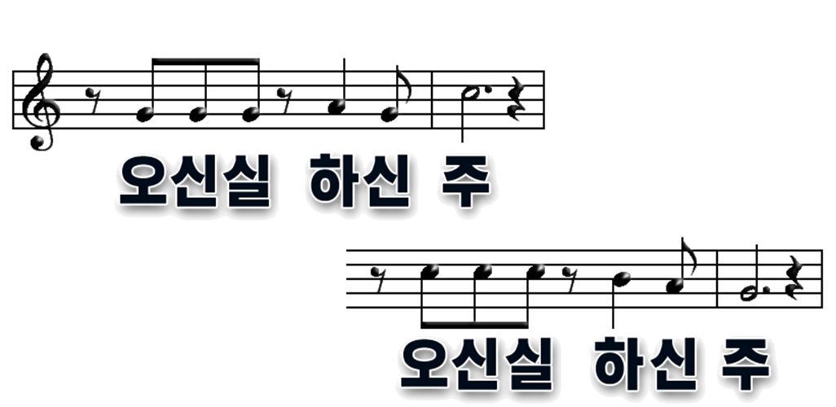
1
2

Slide 4

1
2

Slide 5
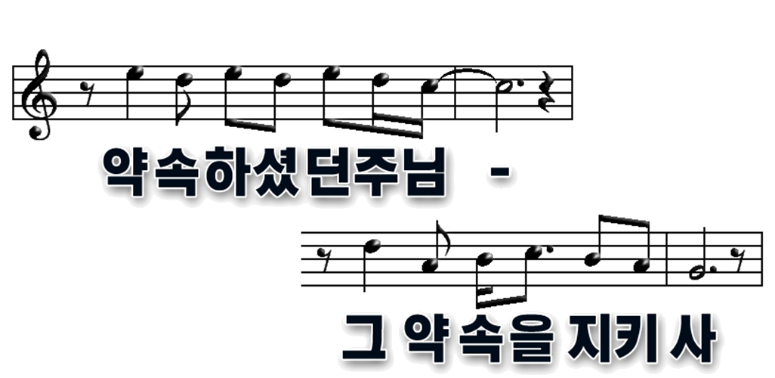
1
2

Slide 6

1
2

Slide 7
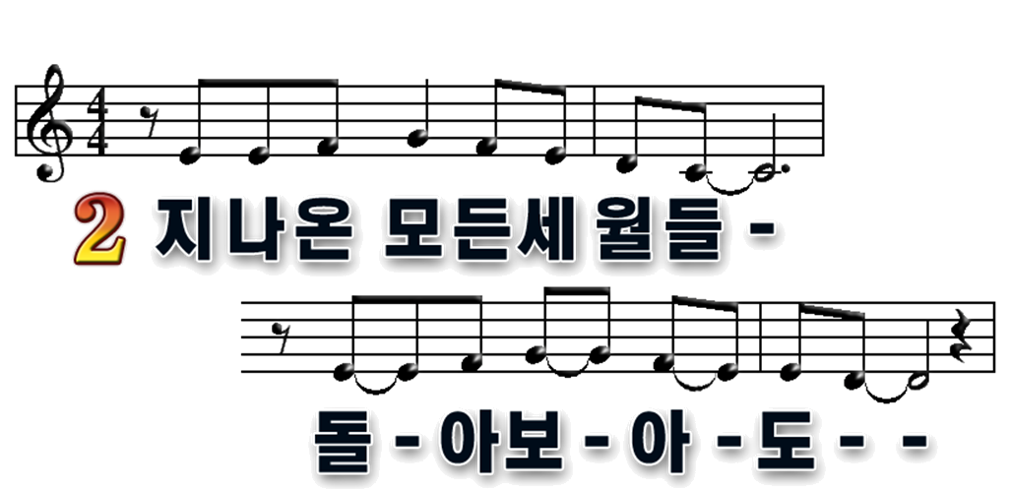
1
2

Slide 8

1
2

Slide 9
1
2

Slide 10
1
2

Slide 11
1
2

Slide 12

1
2

